Slide 1
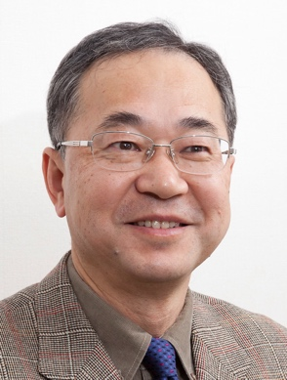
C³ Lecture
Aula Aula IV at 12-13:00
Dipartimento di Chimica «Giacomo Ciamician»
Via Selmi 2 , Bologna
3th November 2022
Chair: Prof. Walter Cabri
"Utilization of Energy of Photons for Organic Synthesis"
Prof. Masahiro Murakami
Professor Emeritus at Kyoto University
Japan
TEAMS https://teams.microsoft.com/dl/launcher/launcher.html?url=%2F_%23%2Fl%2Fmeetup-join%2F19%3Ameeting_Mjc4NWE1MmYtMjU0MC00ZjM3LTk1ZTgtYzM5M2Q3NTRjOGZl%40thread.v2%2F0%3Fcontext%3D%257b%2522Tid%2522%253a%2522e99647dc-1b08-454a-bf8c-699181b389ab%2522%252c%2522Oid%2522%253a%2522bd0a5fff-617b-413b-b98c-4650fd7c65d3%2522%257d%26anon%3Dtrue&type=meetup-join&deeplinkId=8c84e1f4-9ac2-4fc2-8f2a-7f117443e675&directDl=true&msLaunch=true&enableMobilePage=true&suppressPrompt=true
Contacts: i.rivalta@unibo.it; segreteria.c3@unibo.it https://centri.unibo.it/c3/en

